Slide 1
Java 4 WEB
Lesson 5 – Collections Framework

Slide 2

Lesson goals
Collections framework
Notes:
A collection is a generic term that refers to a container of objects.

Slide 3
Collections Framework
List
Set
Map
…

Slide 4
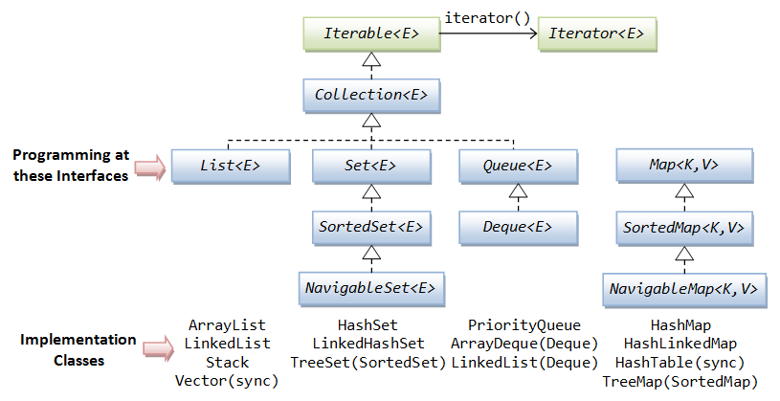
Iterable

Slide 5
Iterator vs Iterable
interface Iterable<T> { Iterator iterator();
void forEach(Consumer<? super T> action)
Spliterator<T> spliterator()
}
interface Iterator<E> { boolean hasNext(); E next(); void remove();
void forEachRemaining(Consumer<? super E> action); }

Slide 6
Collection
int size(); boolean isEmpty(); boolean contains(Object o);
boolean containsAll(Collection c);
Iterator<E> iterator(); boolean add(Object e);
boolean addAll(Collection c); boolean remove(Object o);
boolean removeIf(Predicate<? super E> filter)
boolean retainAll(Collection<?> c);
Stream<E> stream()
Object[] toArray();
…
Notes:
boolean removeAll(Collection c);
void clear();
default Stream<E> parallelStream()
Spliterator<E> spliterator()
int hashCode();
boolean equals(Object o);

Slide 7
Collection iteration
Collection list = Arrays.asList(1, 2, 3, 4, 5);
for (int index = 0; index < list.size(); index++) { System.out.println(list.get(index)); }
1
≈2≈3≈4≈5
Iterator iterator = list.iterator(); while (iterator.hasNext()) { System.out.println(iterator.next()); }
for (Object element: list) { System.out.println(element); }
list.forEach(item -> { System.out.println(item); });
list.forEach(System.out::println);

Slide 8
List
Can not contain primitives
List is like a resizable array
Ordered
Allows duplicate entries
ArrayList, LinkedList,
Notes:
Vector, Stack

Slide 9
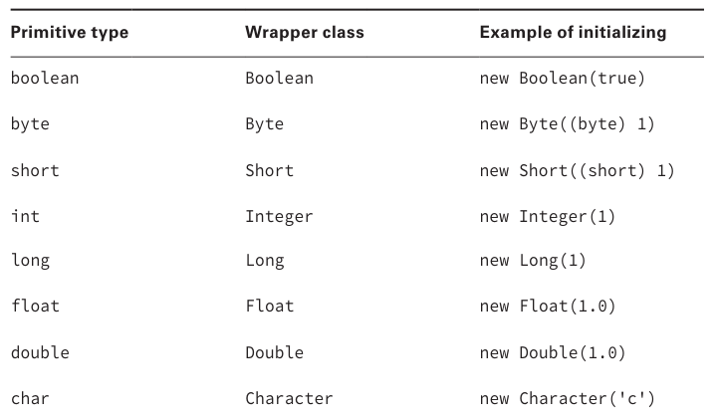
Wrappers

Slide 10
ArrayList
List lessons = new ArrayList(); lessons.add("Intro"); lessons.add("OOP"); lessons.add("Collections"); print("All: " + lessons); // [Intro, OOP, Collections] print("Total count: " + lessons.size()); // Total count: 3 print("Last: " + lessons.get(lessons.size() - 1)); // Last: Collections
lessons.remove("OOP"); print("All except removed OOP: " + lessons); // [Intro, Collections]

Slide 11
ArrayList vs array
String[] stringsArray = new String[]{"Intro", "OOP", "Collections"}; List stringsArrayList = new ArrayList();
stringsArrayList.add("Intro");
stringsArrayList.add("OOP");
stringsArrayList.add("Collections"); print(stringsArray); // [Ljava.lang.String;@6474c2 print(stringsArrayList); // [Intro, OOP, Collections]
stringsArrayList.remove("OOP");

Slide 12
LinkedList
List linkedList = new LinkedList();
linkedList.addFirst(2); // 2 linkedList.addLast(3); // 2 3 linkedList.offerFirst(1); // 1 2 3 linkedList.offerLast(4); // 1 2 3 4 linkedList.add(5); // 1 2 3 4 5 linkedList.remove(3); // 1 2 3 5 (removes by index) linkedList.remove(new Integer(3)); // 1 2 5 (removes by value) linkedList.removeFirst(); // 2 5 linkedList.removeLast(); // 2 linkedList.indexOf(2); // index = 0
Notes:
implements both List and Queue
you can access, add, and remove from the beginning and end of the list in constant time (good choice when you’ll be using it as Queue)

Slide 13
Set
does not allow duplicates
HashSet, LinkedHashSet, TreeSet

Slide 14
HashSet
Stores its elements in a hash table. Uses the hashCode()method of the objects to retrieve them more efficiently
benefit is that adding elements and checking if an element is in the set both have constant time
tradeoff is that you lose the order in which you inserted the elements
(TreeSet stores its elements in a sorted tree structure)

Slide 15
HashSet
Set set = new HashSet(); set.add(1); // 1 set.add(2); // 1 2 set.add(1); // 1 2 set.contains(1); // true set.contains(3); // false set.remove(2); // 1

Slide 16
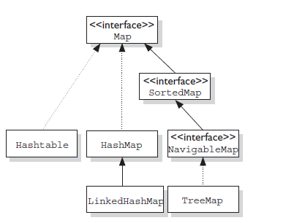
Map

Slide 17
Map
HashMap stores the keys in a hash table
Benefit is that adding elements and retrieving the element by key both have constant time.
The tradeoff is that you lose the order in which you inserted the elements
TreeMap stores the keys in a sorted tree structure
Benefit is that the keys are always in sorted order.
The tradeoff is that adding and checking if a key is present are both O(log n).
LinkedHashMap, Properties, Hashtable
Notes:
You use a map when you want to identify values by a key

Slide 18
Map
boolean isEmpty() int size()
boolean containsKey(Object key) boolean containsValue(Object) V get(Object key) V put(K key, V value) V remove(Object key) V putIfAbsent(K key, V value) V getOrDefault(Object key, V defaultValue)
void forEach(BiConsumer<? super K, ? super V> action)
Set<K> keySet() Collection<V> values()
…
Notes:
void clear();
merge(), void putAll(Map<? extends K, ? extends V> m)
Set<Map.Entry<K, V>> entrySet()
boolean equals(Object o)
int hashCode()
void replaceAll(BiFunction<? super K, ? super V, ? extends V> function)
boolean replace(K key, V oldValue, V newValue)
V computeIfPresent(K key, BiFunction<? super K, ? super V, ? extends V> remappingFunction)
V computeIfAbsent(K key, Function<? super K, ? extends V> mappingFunction)

Slide 19
HashMap
Map map = new HashMap(); map.put("koala", "bamboo"); map.put("lion", "meat"); map.put("giraffe", "leaf"); for (Object key : map.keySet()) { System.out.println(key + ":" + map.get(key)); // koala:bamboo giraffe:leaf lion:meat } map.forEach((key, value) -> { System.out.println(key + ":" + value); // koala:bamboo giraffe:leaf lion:meat });

Slide 20
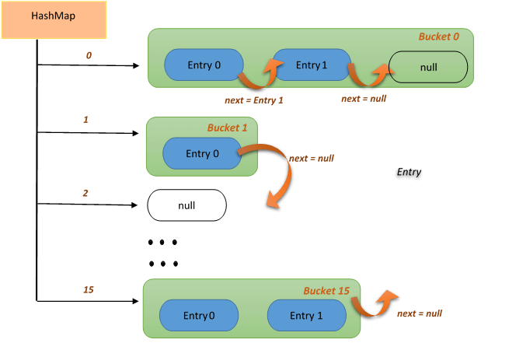
HashMap

Slide 21
Coding equals, hashCode and toString
print(1); print("Hello"); print(new Bird("Tweety")); print(new Bird("Tweety").hashCode()); print(new Bird("Tweety").equals(new Bird("Tweety")));

Slide 22
Coding equals, hashCode and toString
print(1); // 1 print("Hello"); // Hello print(new Bird("Tweety")); // Bird@6474c2 print(new Bird("Tweety").hashCode()); // 6583490 print(new Bird("Tweety").equals(new Bird("Tweety"))); // false

Slide 23
toString
class Bird { String name; public Bird(String name) { this.name = name; } @Override public String toString() { return name; } }
class Main { public static void main(String[] args) { System.out.println(new Bird("Tweety")); // Tweety } }

Slide 24
equals
public boolean equals(Object obj) { return (this == obj); }
Notes:
Method equals() is used to determine whether two objects of a class should be considered equal or not
Java uses == to compare primitives and for checking if two variables refer to the same object.
Checking if two objects are equivalent uses the equals() method, or at least it does if the developer implementing the method overrides equals().

Slide 25
equals
class Bird { String name; public Bird(String name) { this.name = name; } @Override public boolean equals(Object o) { if (this == o)
return true; if (o == null || getClass() != o.getClass())
return false; Bird bird = (Bird) o; return Objects.equals(name, bird.name); } }

Slide 26
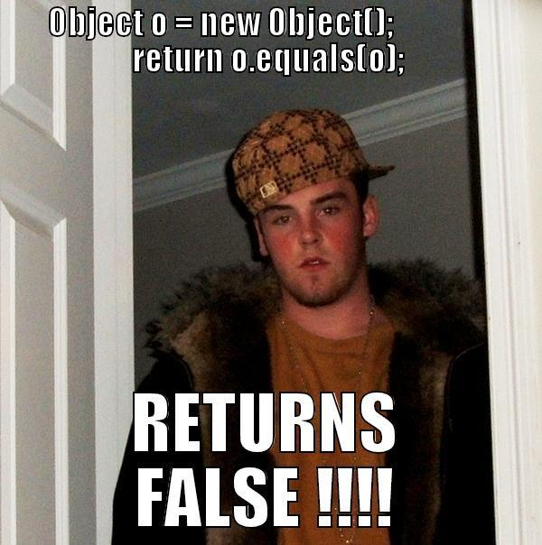
equals

Slide 27
equals - rules
Reflexive: For any non‐null reference value x, x.equals(x) should return true;
Symmetric: For any non‐null reference values x and y, x.equals(y) should return true if and only if y.equals(x) returns true;
Transitive: For any non‐null reference values x, y, and z, if x.equals(y) returns true and y.equals(z) returns true, then x.equals(z) should return true;
Consistent: For any non‐null reference values x and y, multiple invocations of x.equals(y) consistently return true or consistently return false, provided no information used in equals comparisons on the objects is modified;
For any non‐null reference value x, x.equals(null) should return false

Slide 28
equals - what is wrong
@Override
public boolean equals(Bird obj) { if (obj == null) { return false; } return this.name == obj.name; }
Notes:
Compilation fail

Slide 29
equals - what is wrong
@Override
public boolean equals(Bird obj) { if (obj == null) { return false; } return this.name == obj.name; }
Notes:
Compilation fail

Slide 30
hashCode
Whenever you override equals(), you are also override hashCode()
Within the same program, the result of hashCode() must not change
If equals() returns true when called with two objects, calling hashCode() on each of those objects must return the same result.
If equals() returns false when called with two objects, calling hashCode() on each of those objects may return the same result.
Notes:
A hash code is a number that puts instances of a class into a finite number of categories.

Slide 31
hashCode
class Bird { String name; public Bird(String name) { this.name = name; } @Override public int hashCode() { return Objects.hash(name); } }

Slide 32
equals, hashCode and toString combination
class Bird { private final String name; public Bird(String name) { this.name = name; } @Override public String toString() { return "Bird{" + "name=" + name + '}'; } @Override public boolean equals(Object o) { if (this == o) { return true; } if (o == null || getClass() != o.getClass()){ return false; } Bird bird = (Bird) o; return Objects.equals(name, bird.name); } @Override public int hashCode() { return Objects.hash(name); } }

Slide 33
Literature
Collections
Cheat sheet

Slide 34
Homework Task 1
Implement the Car class with the next properties:
- String name
- int power
- String model
- Color {int red, int green, int blue}
Implement for class the methods toString, hashCode and equals. Two cars are identical if they have the same color, power and model. Validate values of color to be red, green, blue should be in range between 0-255.

Slide 35
Homework Task 2: Implement interface
interface SetOperations { /* Two sets A and B are equal (A = B) if they consist of the same elements */ boolean equals(Set a, Set b); /* A union (sum) of sets A and B is a set A ∪ B whose elements belong to at * least one of these sets */ Set union(Set a, Set b); /* The difference between sets A and B is the set AB whose elements belong to * the set A, but do not belong to the set B */ Set subtract(Set a, Set b); /* The intersection (product) of sets A and B is the set A ∩ B whose elements * belong to both the set A and the set B */ Set intersect(Set a, Set b); /* A symmetric difference of the sets A and B is the set A Δ B, which is the union * of the differences of the sets AB and BA, that is, A Δ B = (AB) ∪ (BA) */ Set symmetricSubtract(Set a, Set b); }

Slide 36
Homework Task 3
Implement the "Box for voting". The box must implement the Collection interface. It must accept a Vote object (the bulletin) that contains the name of the candidate. If the bulletin contains the name given by the constant # 1, it should NOT fall into the box when you add it. If the bulletin contains the name given by the constant # 2, it should be magically duplicated when added. All other Vote objects must be added in the usual way

Slide 37
Homework Task 4 Performance test
Implement performance test for different List implementations (ArrayList, LinkedList, Vector). Compare get\add\remove\set values in the beginning\middle\end of the collection;
Implement performance test for different Set implementations (HashSet, LinkedHashSet, TreeSet). Compare add\remove\contains values in collection;
Implement performance test for different Map implementations (HashMap, LinkedHashMap, TreeMap). Compare insertion\removal\update\contains values in the beginning\middle\end of collection.

Slide 38
Q&A

